Slide 1
From Pitched to Published:
Establishing Yourself in a Crowded Media Landscape
- Ira Kantor, Account Manager, Porter Novelli (Boston)

Slide 2

What’s Changed in Media
  Smaller news staffs
    PR professionals currently outnumber journalists 6-1
  The term “beat” has become more loosely defined
  Greater emphasis on online publication versus the printed word
  For many publications, storylines can be driven by outside organizations and agencies
Notes:
Fewer reporters on staff means there are fewer opportunity windows to get your point across to them; they are becoming more selective in what they write about.
Reporters are now encouraged to think beyond one area of expertise to account for smaller staffs.
There is higher demand for real-time news so every second has become crucial in terms of influencing storylines and messaging.
However, to accomplish Bullet 4, there are several tools to consider which are outlined in subsequent slides.

Slide 3

1. Newsjacking
  Definition – Read/see what’s making news in real-time and determine ways to insert yourself into the story, subsequently or otherwise
  Consider the stock market model
    You have from 8 am to 4 pm to make yourself heard (a.k.a. the clock is ticking!)
  Monitor newspapers and other media (i.e. online, trade) frequently
  Determine if your organization fits within a specific story narrative or framework
  Use trends as pitching springboard (i.e. awareness months, holidays, breaking news)
  Draft 2-3 insight bullets to peak reporters’ interest quickly
Notes:
The more forward-thinking you are in what you discuss, the higher the publication you can target (i.e. national media).
Consider which “expert” you are putting forth; the higher the executive or the more specialized they are, the greater chance there is of them being interviewed.
What should your expect be able to say?: Is something good or bad?; Why something is important; An opinion that hasn’t already been determined
While being printed is never a guarantee, it NEVER hurts to try!

Slide 4
2. Pitch Writing
  Less is always more
  Get to the point
  Emphasize the feature angle
  Know your targets
  Make it relevant
  Include the human element
Notes:
Reporters typically only care about what’s in the first two paragraphs of your pitch; if you can’t get to the point quickly, you lose their interest.
Be direct in your subject line (i.e. “Expert available to discuss…”).
Consider how what your SME has to say impacts news as it happens – are they thinking beyond what’s already written?
Local reporters won’t care what’s happening in another state; that’s why it’s important to know the differences between vertical, horizontal, local, and top-tier outlets.
Try to tie your pitch to major trends (i.e. awareness months, holidays, breaking news).
Always be thinking: “How does this affect me?”

Slide 5
3. Press Release Writing
  Ensure your message is direct and as easy to decipher as possible
  Put the 5 W’s – Who, What, Where, When, Why – as high up as possible
  Emphasize a feature angle whenever possible
  Consider the following questions when drafting:
    Why is this important?
    How does this affect me?
  Keep releases, if possible, to no more than a page (two max)
Notes:
If an easy-to-digest message can’t be achieved in a release, transfer the ease of wording to a pitch.
For pitches, the 5 W’s can usually be found in Paragraph 2; for press releases, it’s usually Paragraph 1.
Be descriptive and think of the human element.
If reporters have further questions, this sets the stage for future interviews/briefings; that’s why excessive release length is most often unnecessary.

Slide 6

4. Media Interaction
  Never view media list building as a chore
  Be as nice as possible to reporters in both your words and dialogue
  Prepare yourselves for how reporters think
  Every employee is important…but reporters love the C-Suite
  Consider social media and networking tools where appropriate
Notes:
You learn who covers which beat when you take the time to properly research prospective media targets.
Don’t pitch close to deadline time, unless breaking news occurs.
Wait an appropriate period of time before following up with reporters; unless an event is taking place, no need to risk alienating them early.
Reporters work in yin-yangs; if a story is too soft or fluffy, they won’t see the news value.
At the same time anticipate reporters will try to poke holes in your story to give it more of an objective feel.
Very rarely will reporters provide drafts of their work back to you for review.
Keep bios and headshots handy for pitches and reporters.
Make sure your expert is available before pitching; don’t promise them something you can’t provide!

Slide 7
Some Quick ABCs of What Makes News
  Acquisitions, Animals, Arts
  Breakthroughs (Tech, Health, etc.), Bruins, Business
  Celebrities, Celtics, Crime, Crises
  Deaths, Disease (Treatment)
  Earnings, Economy, Events
  Fundraising
  History, Holidays, Humanity
  International Affairs
  Legal Developments, Lifestyle
  #MeToo, Milestones, Movements
  Partnerships, Patriots, Personnel Shifts, Philanthropy, Politics
  Race, Real Estate, Red Sox
  Science, Selflessness, Sports
  Technology, Tragedies, Triumphs
  World Events, World Series
  Year-over-Year Goals and Events

Slide 8
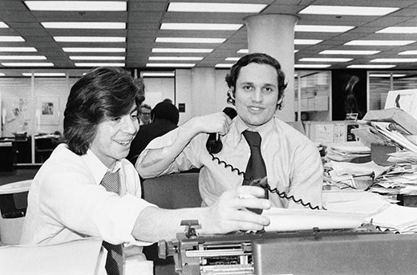
THANK YOU
Ira Kantor
Account Manager, Porter Novelli (Boston)
Phone: 617-897-8202
Email: ira.kantor@porternovelli.com

